Slide 1
Course Registration
School Counseling Department
Parkville High School

Slide 2
Today’s Objectives
Review academic graduation requirements
Review Completer Program options
Timeline/overview of the course selection process
Review instructions for completing the pre-registration worksheet

Slide 3
Subject | Freshman | Sophomore | Junior | Senior
English (4 cr.) | ESOL 1 = English 9 | English 10 | English 11 | ESOL 2 = English 12
Social Studies (3.5 cr.) | American Government | World History | US History | PFET (.5)
Math (3 cr.) | Algebra 1 | Algebra 2 | Geometry | 4th Math
Science (3 cr.) | Earth Systems | Living Systems | Integrated Chem. & Physics | Science Elective
PE (1 cr.) | ✓
Health (.5 cr.) |  |  | ✓
Technology (1 cr.) | ✓
Fine Art (1 cr.) | ⎫
Completer Sequence (4 cr.) | World Language, Advanced Technology, or CTE Program
Total Credits: 21

Slide 4
Registration Timeline
Teacher recommendations have been completed.
November 25- video broadcasted on Knightly News and pre-registration forms mailed home with report cards.
November 26-December 1- Students will review pre-registration form and share with family.
Students will give pre-registration form to their counselor at registration meeting.
December 2- January 15: Counselors will individually meet with students to select their course requests for the 2021-2022 academic year and collect pre-registration form.
Spring 2021: Students will receive a printout of course REQUESTS to bring home and review. Both student and parent should sign off on the choices selected and return.
YOU HAVE UNTIL THE LAST DAY OF SCHOOL TO MAKE REQUEST CHANGES

Slide 5
Courses listed on your pre-registration form are automatic suggestions based on classes that you are currently taking.
Electives offered at Parkville are listed below these courses.
College bound students must take English, Social Studies, Math, and Science every year.

Slide 6
College/World Language COmpleter
Spanish
French
German
2 credits of World Language in high school
1 math credit beyond Algebra 1, 2, Geometry
1 elective (science recommended)

Slide 7
Advanced technology
Pre-requisite: Foundations of Engineering
Advanced Design Applications (1 cr)
(11th or 12th grade)
Advanced Tech Applications (1 cr)
(11th or 12th grade)
PLUS
Any 2 elective credits

Slide 8
Career Research & Development
Intro to Career Research and Development (1cr)
(10th or 11th grade)
Adv. Career Research and Development (1cr)
Work-Based Learning (2 cr) (270 hours of work required)
(12th grade)

Slide 9
Information technology: networking/cyber security
Networking Completer 1 (1 cr) and
Networking Completer 2 (1 cr) (10th or 11th grade)
Cyber Security (1 cr) and
Network Defense (1 cr)
(11th or 12th grade)

Slide 10
Graphic arts/Game design
Special permission required to take both IMP 1 & 2 together in 11th grade.
Interactive Media Production 1 (1 cr.)
(Fundamentals of Art suggested Pre-Requisite)
(10th grade)
Interactive Media Production 2 (1 cr.)
(11th grade)
Interactive Media Production 3 (1 cr.)
and
Interactive Media Production 4 (1 cr.)
(12th grade)

Slide 11
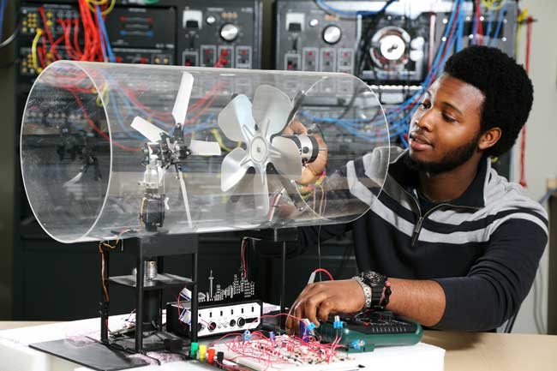
Engineering: Project lead the way (PLTW)
PLTW Introduction to Engineering Design
(9th grade)
PLTW Digital Electronics
(10th grade)
PLTW Principles of Engineering
(10th or 11th grade)
PLTW Computer Integrated Manufacturing
(11th or 12th grade)
PLTW Engineering Design & Development
(12th grade capstone course)

Slide 12
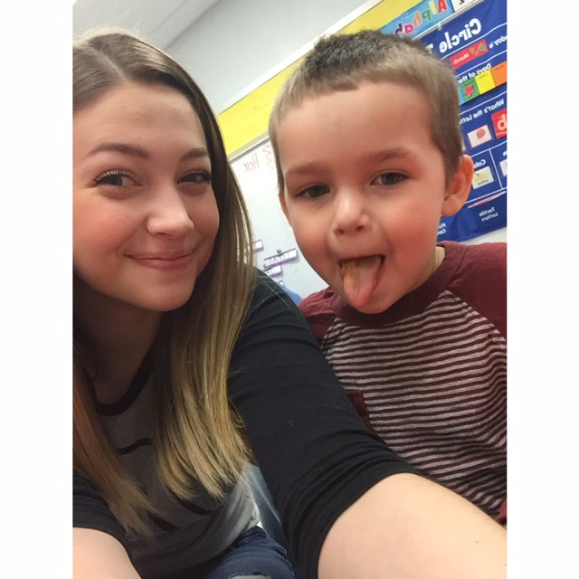
School aged child
Child Development 1 (Hon)(1 cr)
(10th grade)
Child Developmet 2 (Hon) (1 cr)
(11th grade)
Internship Child Develop (Hon) (2 cr) (12th grade)

Slide 13
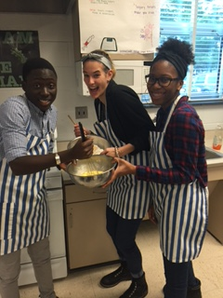
Food science
Nutrition & Foods (1 cr)
(10th grade)
Food Preparation & Management (1/2 cr)
Nutrition & Food Science (1/2 cr)
(11th grade)
Nutrition & Food Science Internship (2 cr)
(12th grade)

Slide 14
Junior Reserves officer training JROTC
Marine JROTC 1 (1cr)
Marine JROTC 2 (1cr)
Marine JROTC 3 (1cr)
*Marine JROTC 4 (1cr)
strongly encouraged not required

Slide 15
Completing the worksheet
Review automatic requests at top of page.
Keeping graduation requirements in mind, draw a line through any listed electives you don’t plan to take.
Place a check mark in the columns next to courses you want to take.
Make sure the total credits selected equals 8.
Place an “A” in the column next to two credits you would be willing to take as an alternate to classes selected in #3.

Slide 16
Senior year options
Attend school all day and take challenging courses.
Get permission to attend school only A or B days.
Work a part-time job
Participate in internship program
School age child
Food Science associate
Career Research & Development
(270 hours of work)
Attend CCBC to earn college credit
CCBC – Early College Access
50% tuition waiver
summer, fall, or spring semesters
Tuition free program
2.5 cumulative GPA
Pay fees and books
If you qualify for free or reduced meals at PHS, fees are waived
Fall & Spring semesters only
Up to 4 college classes throughout your high school career

